Slide 1
Comprehensive Digital Marketing
Project Work- AMUL

Slide 2

Part 1: Brand study, Competitor Analysis & Buyer’s/Audience’s Persona
Company/topic for project: AMUL
Research Brand Identity: Study the brand's mission, values, vision, and unique selling propositions (USPs).
Brand colours: Red, Green and White
LOGO:
FOUNDED : 14 December1946
Founder : Tribhuvandas patel
Head Quarters : Gujarat
Revenue : US$6.5 Billions
Official website : https://amul.com/

Slide 3
Mission/Values :: Amul's mission revolves around providing consumers with high-quality dairy products that meet their nutritional needs. They strive to maintain the quality of their products throughout the supply chain, from sourcing milk to delivering the final product to customers. USP: Unique Selling Propositions Amul offers a diverse range of dairy products, including milk, butter, cheese, yogurt, ice cream, and more. Their extensive portfolio caters to the varied preferences of consumers, allowing them to choose from a wide selection of dairy products under a single brand.. Their focus on affordability without compromising on quality has made them a popular choice for consumers across different segments. Amul's Unique Selling Proposition (USP) lies in its strong commitment to quality, taste, and social responsibility, making it a beloved and trusted brand among consumers
Part 1: Brand study, Competitor Analysis & Buyer’s/Audience’s Persona
Company/topic for project: AMUL

Slide 4
Part 1: Brand study, Competitor Analysis & Buyer’s/Audience’s Persona
Analyze Brand Messaging:
1. Catchy taglines
2. Emphasizing product quality
3. Celebrating the Indian identity
4. Empowering farmers and cooperative spirit
Examine the brand's tagline:
Amul is well-known for its creative and memorable taglines that often incorporate wordplay and humor. For example, their iconic tagline "Utterly Butterly Delicious" for Amul Butter has become deeply ingrained in popular culture in India. These taglines not only grab attention but also evoke positive emotions and create a lasting impression.

Slide 5
Part 1: Brand study, Competitor Analysis & Buyer’s/Audience’s Persona
Competitor Analysis: Select three competitors operating in the same industry or niche as the chosen brand, examine their USPs and online communication.
Competitor 1:https://www.motherdairy.com/
Mother Dairy: Mother Dairy is a well-known Indian dairy company that offers a wide range of dairy products. It is known for its milk, butter, ice cream, yogurt, and cheese. Mother Dairy focuses on providing quality products, supporting farmers, and promoting healthy living.
Competitor 2:https://www.nestle.in/
Nestlé: Nestlé is a multinational food and beverage company that has a significant presence in the dairy industry. They offer a diverse range of dairy products, including milk, yogurt, ice cream, and cheese. Nestlé emphasizes product quality, nutritional value, and global brand recognition.
Competitor 3:https://www.britannia.co.in/
Britannia Industries: Britannia Industries is an Indian food company that manufactures and sells dairy-based products. While primarily known for its biscuits, Britannia also offers dairy products such as cheese, butter, and dairy beverages. They have a strong brand presence in India and a wide distribution network.

Slide 6
Part 1: Brand study, Competitor Analysis & Buyer’s/Audience’s Persona
Buyer's/Audience's Persona: Clearly define the target audience for the chosen brand. Consider demographics, psychographics, behaviors, and interests.
Demographics:
Amul's target audience includes health-conscious individuals from various socio-economic backgrounds, ensuring that their nutritious dairy products are accessible to a wide range of consumers. Additionally, their products are also popular among vegetarian consumers, as Amul is known for its range of vegetarian-friendly dairy items.
Psychographics:
Amul products resonate with people who value the convenience of ready-to-eat and easy-to-use dairy options, such as packaged milk and yogurt. Additionally, the brand appeals to consumers who prioritize supporting local industries and rural development, as Amul's cooperative model directly benefits small-scale dairy farmers.

Slide 7
Behaviors and Interests: Amul's target audience consists of trend-conscious consumers who appreciate the brand's efforts to introduce innovative dairy products and flavors in response to evolving market preferences. The brand's occasional limited-edition or seasonal offerings attract collectors and enthusiasts looking for unique experiences and products. Furthermore, Amul attracts health-conscious parents concerned about their children's nutrition, as the brand offers a wide range of dairy products fortified with essential vitamins and minerals, promoting overall well-being. These parents also appreciate the reliability and consistency of Amul's products, ensuring their family's daily nutritional needs are met.
Part 1: Brand study, Competitor Analysis & Buyer’s/Audience’s Persona

Slide 8
Part 2: SEO & Keyword Research
SEO Audit: Do an SEO audit of the brands website
Keyword Research :
Distinguish important watchwords connected with Amul's items, administrations, and industry. Use instruments like Google Watchword Organizer, SEMrush, or Ahrefs to track down well known and high-traffic catchphrases.
On-Page SEO Analysis :
Check the title labels, meta depictions, and header labels (H1, H2, and so on) to guarantee they incorporate designated watchwords and are enhanced for client commitment.
Investigate the substance for significance, quality, and catchphrase utilization.
Check for legitimate inward connecting and anchor text advancement.
Competitor Analysis :
Examine the Website design enhancement systems of rivals in a similar industry to recognize areas of progress.
https://youtu.be/lJkZB4pBUrE

Slide 9
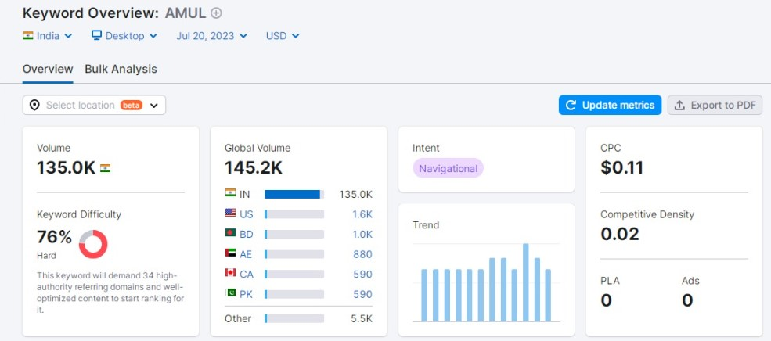
Keyword Research: Define Research Objectives, Brainstorm Seed Keywords, Utilize Keyword Research Tools (SEMrush or Moz Keyword Explorer),Analyze Competitor Keywords, Long-tail Keyword Exploration (specific, longer phrases) that align with the research objectives and have lower competition but higher conversion potential. Brainstorm Seed Keywords : Seed keywords are the basic terms that are directly related to Amul. Here are some seed keywords: Amul Amul dairy products Amul butter Amul milk Amul ice cream Amul cheese Amul ghee Amul chocolates Amul yogurt Amul paneer Utilize Keyword Research Tools: Using tools like SEMrush or Moz Keyword Explorer, we can perform keyword research to find relevant keywords and analyze their search volume, competition, and potential

Slide 10
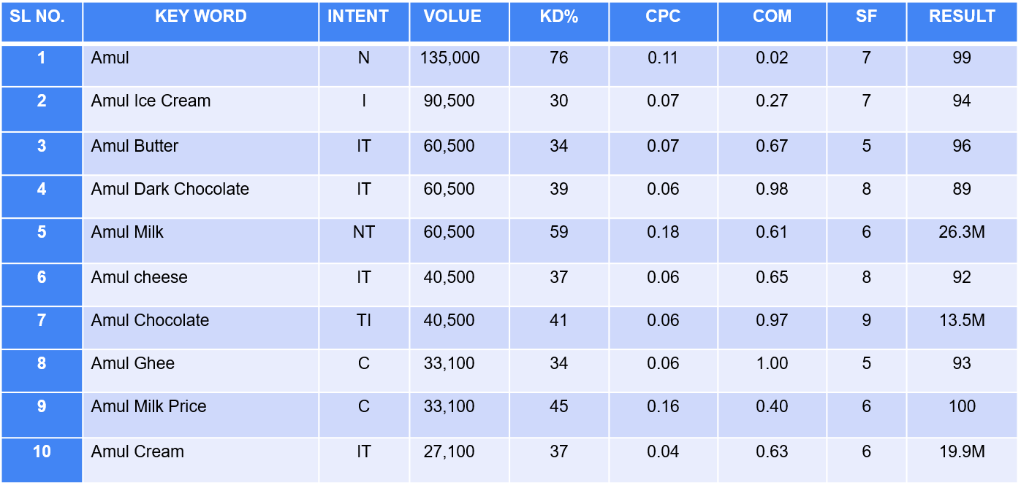

Slide 11
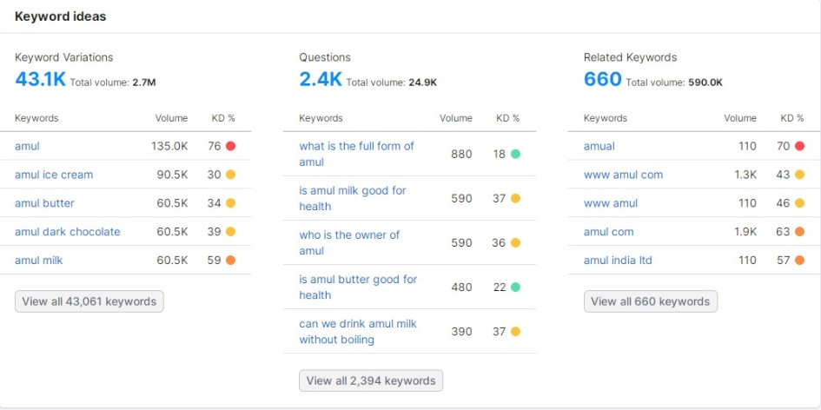
https://youtu.be/hW7z6iF1BNc

Slide 12
On page Optimization: Meta Tag optimization & content optimization Reflect on the process of conducting keyword research and the SEO recommendations provided. Document the challenges faced during the research and analysis phase, as well as the key insights gained from the keyword research process. Conducting Keyword Research : a. Brainstorming: The first step is to brainstorm potential keywords that are relevant to the webpage's content and business. This can involve thinking about common terms and phrases users might use when searching for the specific topic. b. Keyword Research Tools: Keyword research tools like Google Keyword Planner, SEMrush, Ahrefs, and Moz Keyword Explorer are invaluable in finding relevant keywords. These tools provide data on search volume, competition, and related keywords. SEO Recommendations : a. Meta Tag Optimization: Meta tags, such as title tags and meta descriptions, play a significant role in on-page SEO. They should be optimized with relevant keywords to improve search engine visibility and click-through rates. b. Content Optimization: Incorporating target keywords naturally and strategically throughout the content helps search engines understand the page's relevance. It also enhances user experience by providing valuable information.

Slide 13
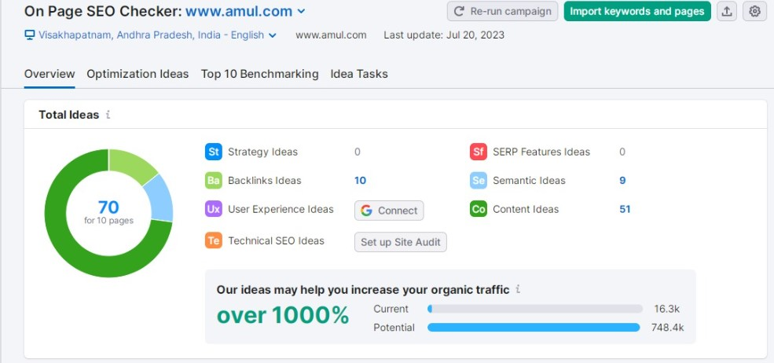

Slide 14
Part 3: Content Ideas and Marketing Strategies
Content Idea Generation & Strategy:
Create a content calendar for the remaining month of July by brainstorming content themes, exploring various formats like blog posts, videos, infographics, podcasts, and interactive quizzes, and scheduling publication dates mainly on Facebook & Instagram and include the strategy, aim and the idea behind these posts and story.
Delightful Discoveries with Amul - A Month of Heritage, Flavor, and Wellness
Welcome to Amul's content calendar for the exciting month of July! Join us as we embark on a journey to celebrate our rich heritage, share delectable recipes, uncover intriguing facts, and offer behind-the-scenes glimpses into the making of our beloved dairy products. With a strategic focus on Facebook and Instagram, we aim to engage our valued audience, foster brand loyalty, and inspire a healthier lifestyle with Amul. Get ready for a month filled with joy, nostalgia, and delightful discoveries as we bring you the best of Amul!

Slide 15
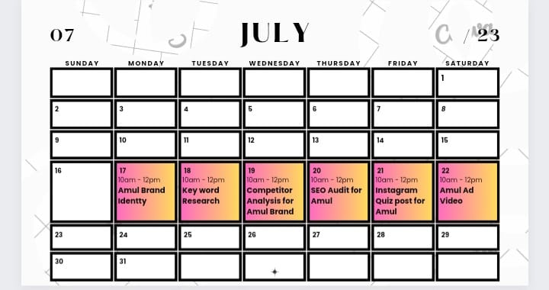
Content Calendar Example (Try creating a table for the month of July)

Slide 16
Part 3: Content Ideas and Marketing Strategies
Content Ideas and Marketing Strategies Process:
Amul's content ideas and marketing strategies have been highly successful due to their creative approach, strong brand identity, and understanding of their target audience. However, like any marketing endeavor, they have encountered challenges and learned valuable lessons along the way.
**Challenges Encountered:**
1. **Maintaining a Consistent Brand Voice:** With a brand as iconic as Amul, maintaining a consistent brand voice across diverse content formats and platforms is crucial. They need to ensure that their humor, wit, and messaging remain consistent, whether it's a video, blog post, or infographic. Straying from their unique brand voice can lead to confusion among the audience and dilute their brand identity.
2. **Creating Engaging Content for Diverse Platforms:** Each social media platform has its own audience demographics and content requirements. Crafting content that effectively engages users on Facebook may not have the same impact on Instagram or other platforms. Adapting content to suit different platforms while maintaining brand authenticity can be challenging.

Slide 17
**Lessons Learned:** 1. **Understanding the Target Audience:** Amul's success can be attributed in part to their in-depth understanding of their target audience. By conducting thorough research and analysis, they have been able to create content that resonates with their customers. Understanding their audience's preferences, interests, and pain points has allowed Amul to tailor content ideas that genuinely connect with their consumers. 2. **Diversifying Content Formats:** Amul has learned that diversifying content formats is essential for capturing and retaining audience attention. By experimenting with various formats like videos, blog posts, infographics, podcasts, and interactive quizzes, they cater to different audience segments and keep their content fresh and engaging. 3. **Building Emotional Connections:** Through their creative storytelling and witty ads, Amul has been successful in building emotional connections with their audience. They've learned that emotional appeal can be a powerful driver of engagement and brand loyalty. 4. **Consistency and Longevity:** Amul's marketing efforts have remained consistent over the years. They have maintained their unique brand voice, leveraging their iconic Amul Girl mascot and humorous tone, which has become deeply ingrained in the minds of consumers. This consistency has helped them stay relevant and memorable in a competitive market. In conclusion, Amul's content ideas and marketing strategies have been shaped by understanding their target audience, maintaining brand consistency, and embracing diversity in content formats. Through challenges and lessons learned, they continue to captivate consumers and remain a beloved brand in India's dairy landscape.

Slide 18
Part 4: Content Creation and Curation (Post creations, Designs/Video Editing, Ad Campaigns over Social Media and Email Ideation and Creation)
Post Creation:
Select Content Categories: Identify three different content formats relevant to the chosen topic or industry. Research and Brainstorm: Research trending topics, industry news, or audience interests within each category. Brainstorm ideas for social media posts that align with each category. Do note that 1 content format has to be video and additionally 3 stories/status are to be created.
Format 1 : Blog article
Aim : Boost SEO & Provide information about Amul products
Date : 20th july 2023
Idea : The aim of the competition is to celebrate the creativity of Amul's customers and encourage them to explore various culinary possibilities with Amul products.
Title : Amul is not just a brand; it is a part of India's cultural fabric, a symbol of unity, progress, and the power of collective efforts. Amul has created a legacy of trust, taste, and tradition. As we savor each bite of their flavorful delights, let us raise a toast to Amul for enriching our lives and nurturing India's dairy heritage with every creamy delight it offers.
https://amul-products.blogspot.com/

Slide 19
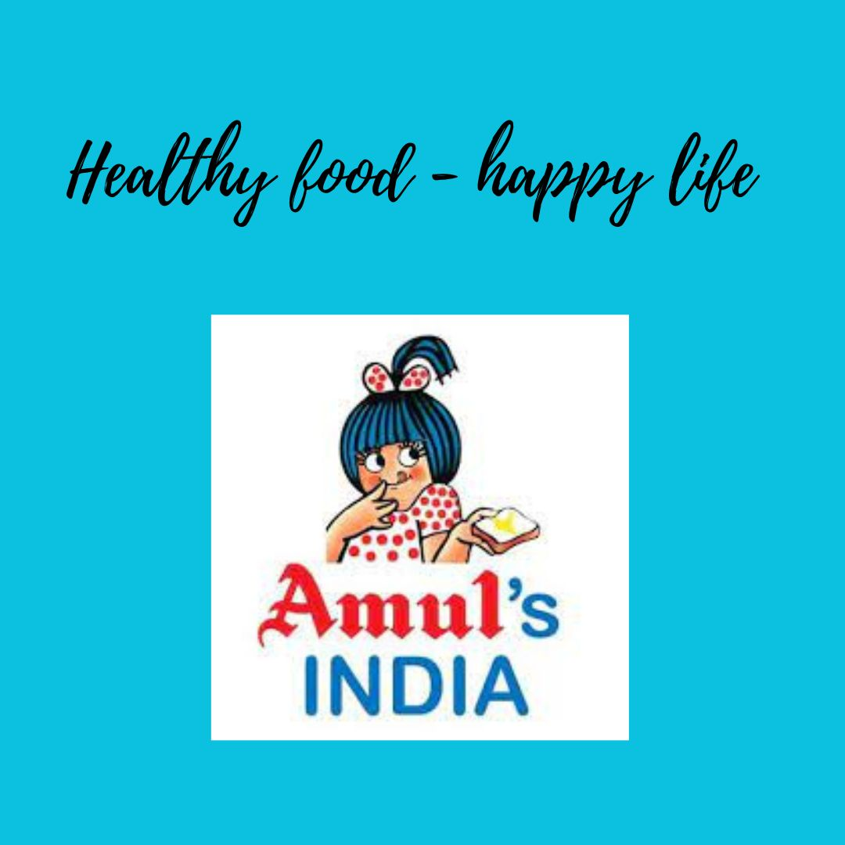
Part 4: Content Creation and Curation (Post creations, Designs/Video Editing, Ad Campaigns over Social Media and Email Ideation and Creation)
Format 2 : Video
Aim : To promote Amul products
Date : 20th July 2023
Idea : Amul has launched different products and we make a video on it.
Topic : https://youtube.com/shorts/edFdjec3SpE?feature=share
Format 3 : Creative
Aim : Brand awareness and reach for Amul products.
Date : 20th July 2023
Idea : To create a meme on the trending topic : Amul

Slide 20
Part 4: Content Creation and Curation (Post creations, Designs/Video Editing, Ad Campaigns over Social Media and Email Ideation and Creation)
Instagram Story
Utilize the Stories feature on Instagram for three consecutive days. Share behind-the-scenes glimpses, polls, quizzes, or sneak peeks etc to encourage audience participation. Once uploaded use the story highlight feature on Instagram and save the 3 story with an appropriate name for each. Note: Once done monitor the performance of the posts and Stories using the insight tool and analyze the engagement metrics (likes, comments, shares, impressions, etc.). Based on the analysis, mention the strategies and areas for improvement.

Slide 21
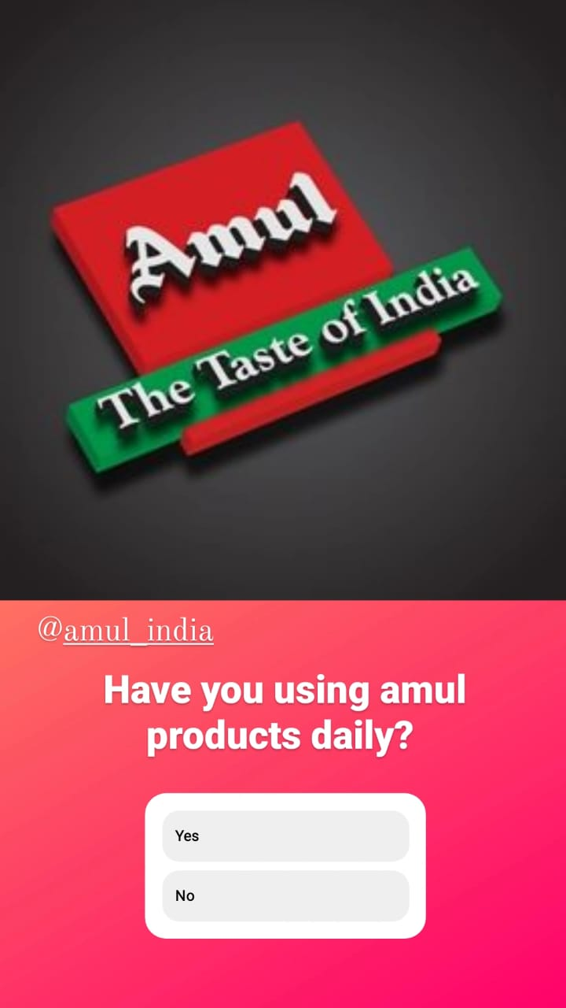
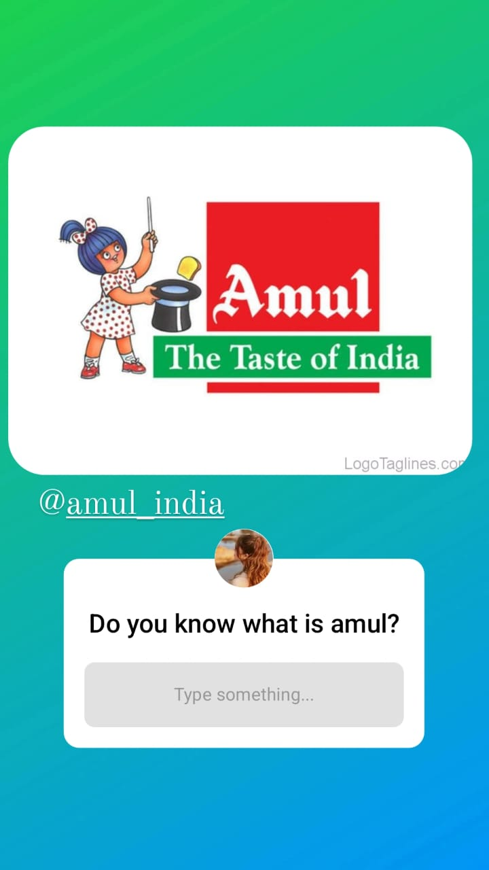
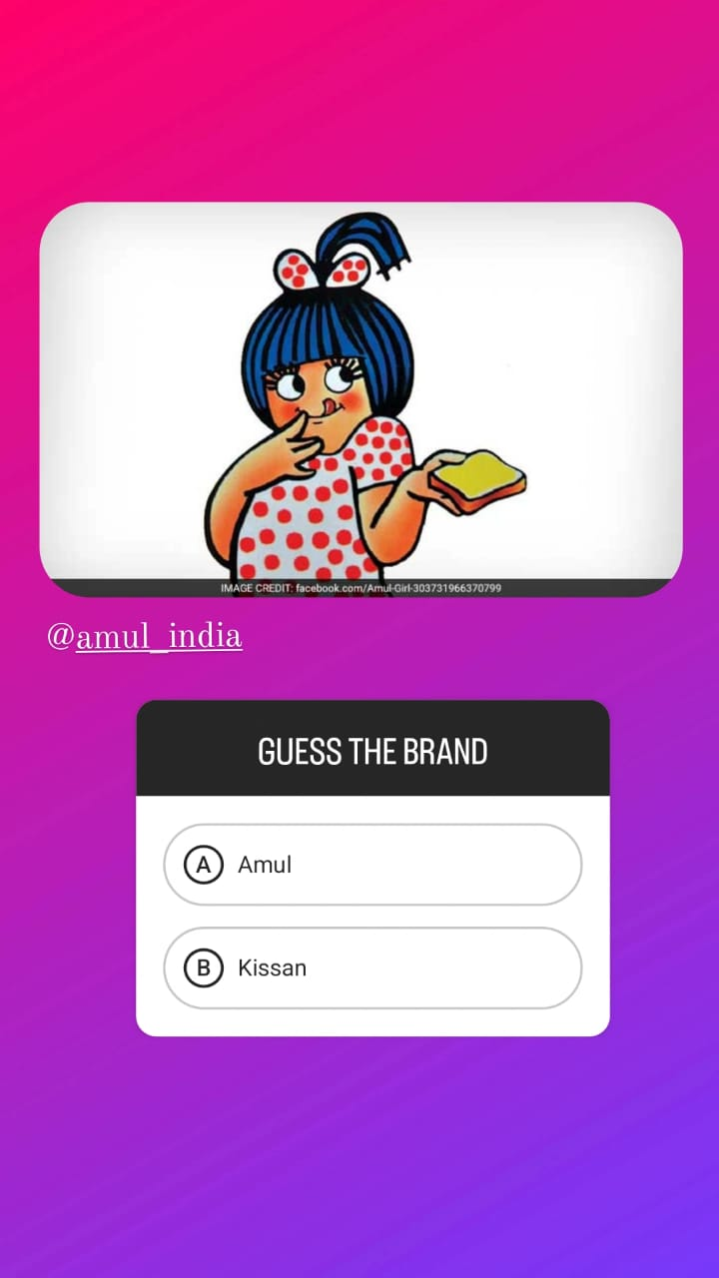
Part 4: Content Creation and Curation (Post creations, Designs/Video Editing, Ad Campaigns over Social Media and Email Ideation and Creation)
Instagram Story

Slide 22
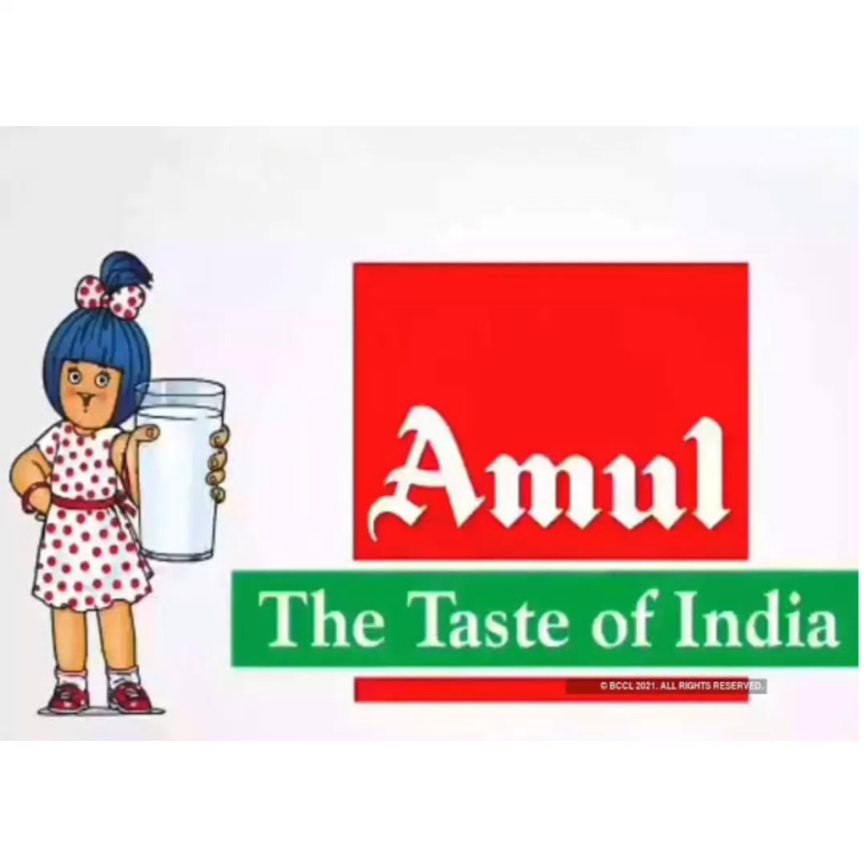
Part 4: Content Creation and Curation (Post creations, Designs/Video Editing, Ad Campaigns over Social Media and Email Ideation and Creation)
Designs/Video Editing
Design Tools Familiarization (use Canva for creating visually appealing graphics)
Video Creation: Utilize VN or any video editor of your choice to create videos related to the chosen topic.

Slide 23
MAKING THE VIDEO FOR AMUL AD
AMUL AD VIDEO LINK :
https://youtu.be/UuGD53xLKqM
The video production process consists of 3 main steps: pre-production, which is the planning stage for mapping out your strategy and script for the video, production is the phase in which the video is shot, and finally post-production, which involves editing the video, adding music and other effects. Let’s walk through the process step by step.
Firstly collect information about AMUL through official websites of Amul.
Secondly collect images and other details about them and ready to plan the process.
Thirdly from the collected data ,make the video by using different editing apps, sites.

Slide 24
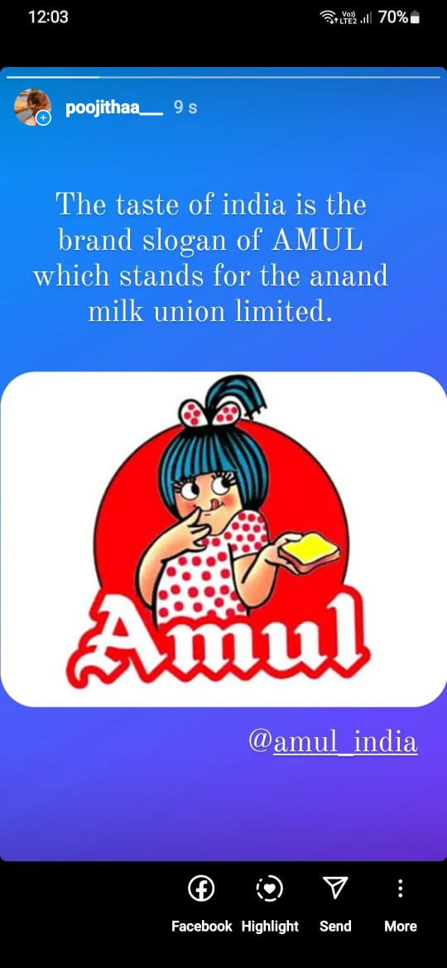
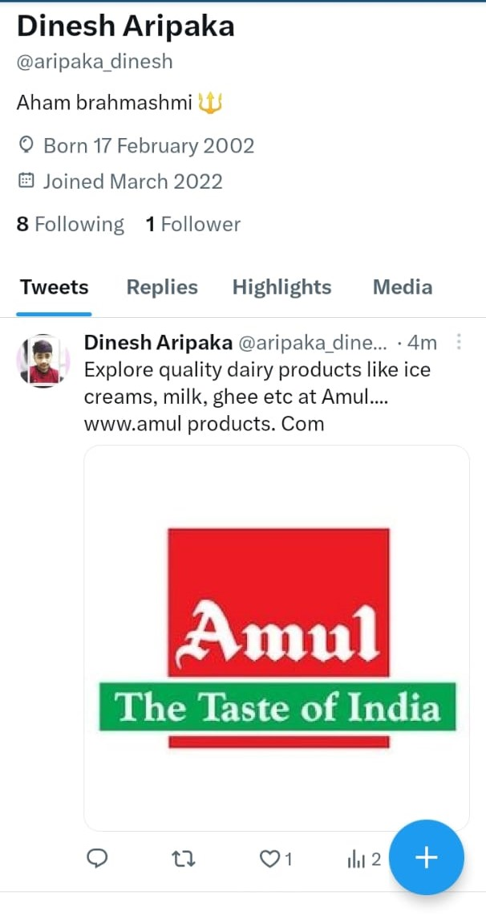
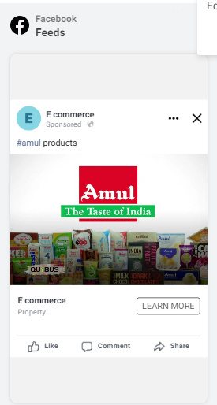
Part 4: Content Creation and Curation (Post creations, Designs/Video Editing, Ad Campaigns over Social Media and Email Ideation and Creation)
Social Media Ad Campaigns
Ad Campaigns over Social Media:
Come up with 3 ad campaigns each covering one of the mentioned goals: brand awareness, driving website traffic, or generating leads

Slide 25
Part 4: Content Creation and Curation (Post creations, Designs/Video Editing, Ad Campaigns over Social Media and Email Ideation and Creation)
For every campaign clearly define:
Advertising Goals: increasing brand awareness, driving website traffic, or generating leads.
Audience Targeting: Define the target audience for the ad campaigns based on demographics, interests, and behavior.
Ad Creation: Create visually appealing ad creatives, compelling ad copy and relevant call-to-action.
Health and Nutrition: In response to growing consumer awareness about health and nutrition, Amul may focus on highlighting the nutritional benefits of their products, especially those that cater to health-conscious consumers.
Targeting New Customer Segments: Amul may aim to reach out to new customer segments and demographics, expanding their market beyond their traditional consumer base.

Slide 26
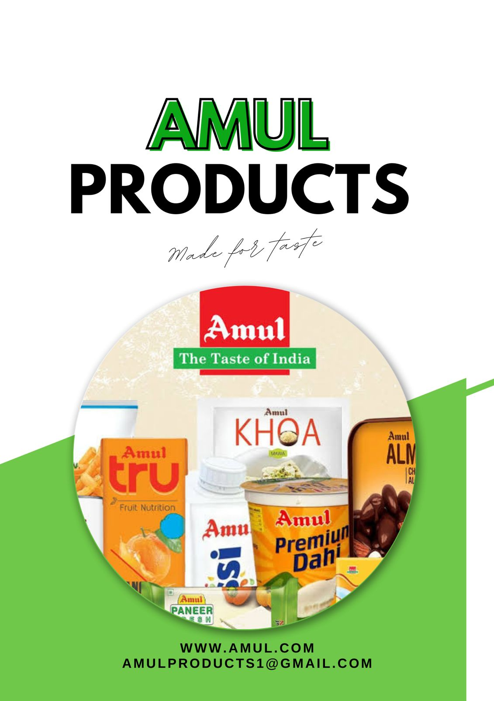
Part 4: Content Creation and Curation (Post creations, Designs/Video Editing, Ad Campaigns over Social Media and Email Ideation and Creation)
Email Ad Campaigns
Ad Campaigns for email marketing:
Come up with 2 email ad campaigns with the mentioned goals: brand awareness & generating leas
Brand awarness for AMUL:
Amul is one of India's most renowned dairy brands, known for its high-quality dairy products.
Ensure that the Amul brand logo, tagline ("The Taste of India"), and brand colors are consistently used across all marketing materials, packaging, and communication channels.

Slide 27
Lead generation for Amul products:
lead generations for amul products involves identifying and attracting potential customers who have expressed interest in or shown a need for Amul's dairy products. Here are some effective lead generation strategies for Amul:
Online Advertising: Utilize online a
dvertising platforms such as Google Ads and social media ads to target specific demographics and regions. Create engaging ad content that highlights the benefits and uniqueness of Amul products.
Content Marketing: Develop high-quality and informative content related to dairy products, nutrition, and cooking using Amul products. This can include blog posts, videos, recipes, and infographics to attract and engage potential customers.
Social Media Marketing: Leverage social media platforms to create a strong presence and engage with the audience. Share valuable content, respond to comments and messages promptly, and run contests or giveaways to encourage participation.

Slide 28
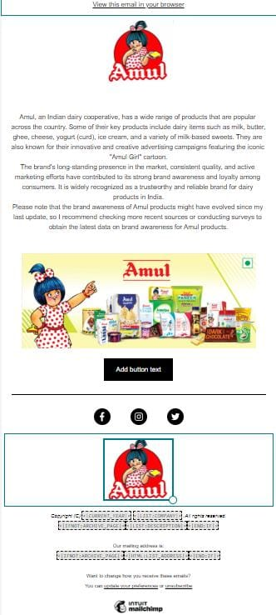
Email Ad Campaign 1 - Brand Awareness
(insert emailer image)

Slide 29
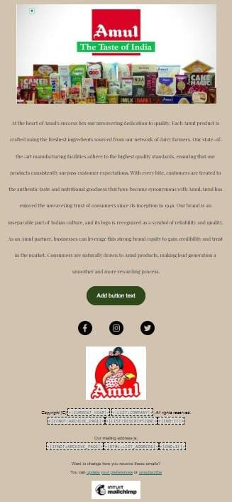
Email Ad Campaign 2 - Lead Generation
(insert emailer image)

Slide 30
Part 4: Content Creation and Curation (Post creations, Designs/Video
Editing, Ad Campaigns over Social Media and Email Ideation and Creation)
Reflect on the content creation and curation process, discussing the challenges faced and lessons learned.
Content Creation:
Content creation involves producing original material such as articles, videos, graphics, or social media posts to engage with the target audience and promote the brand. The process includes brainstorming ideas, researching topics, writing or designing the content, and optimizing it for distribution. Challenges Faced in Content Creation: Inventiveness: Thinking of new and engaging thoughts can be testing, particularly while making content on an ordinary basis. Time The executives: Creating top notch content inside close cutoff times can be troublesome, particularly in the event that there are different undertakings to deal with.

Slide 31
Relevance: Ensuring the content remains relevant and resonates with the audience's interests and needs requires continuous attention. Lessons Learned in Content Creation: Crowd Getting it: Understanding the ideal interest group's inclinations, trouble spots, and interests makes content that requests to them. Quality Over Amount: Zeroing in on delivering significant and very much created content is a higher priority than delivering a huge volume of fair content. Diversification: Investigating different substance designs, like recordings, infographics, or webcasts, permits arriving at various sections of the crowd.

